Slide 1
Risk Management Benchmarking Approaches and Options
Drew Barber, RMIS Consultant
DMB Risk Solutions, LLC

Slide 2
Risk Management Benchmarking Internal vs External
Internal - Organization benchmarks performance against internal sister operations/ entities
Advantages:
Similar operations provide more accurate comparison
Easier to aggregate and report on data
Effective means of performance management
Promotes continuous improvement
Disadvantages
Does not tell how the organization overall performance compared to peer companies
Doesn’t really answer “yeah, but how I am really doing?”
External – Organization benchmarks performance against external peer organizations/ companies
Advantages:
Answers “how am I really doing?”
Gets management attention.
Disadvantages
May be difficult to do (or find benchmarks that are actually useful).
Everyone wants to externally benchmark, but resistant to sharing internal data.

Slide 3
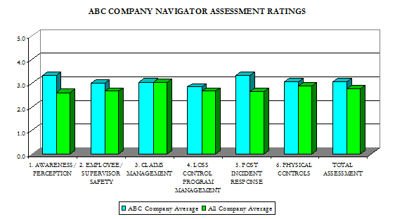
Risk Management Benchmarking Types
Activity Based- Benchmarking against practices and policies. (Leading Indicators)
Advantages:
Easier to share.
Provides ideas that can be adopted in other organizations.
Improvements are quickly shown in risk management rankings
Disadvantages
Doesn’t really address outcomes/ results.
May not motivate the organization.
Measurement of activities may be subjective in nature

Slide 4
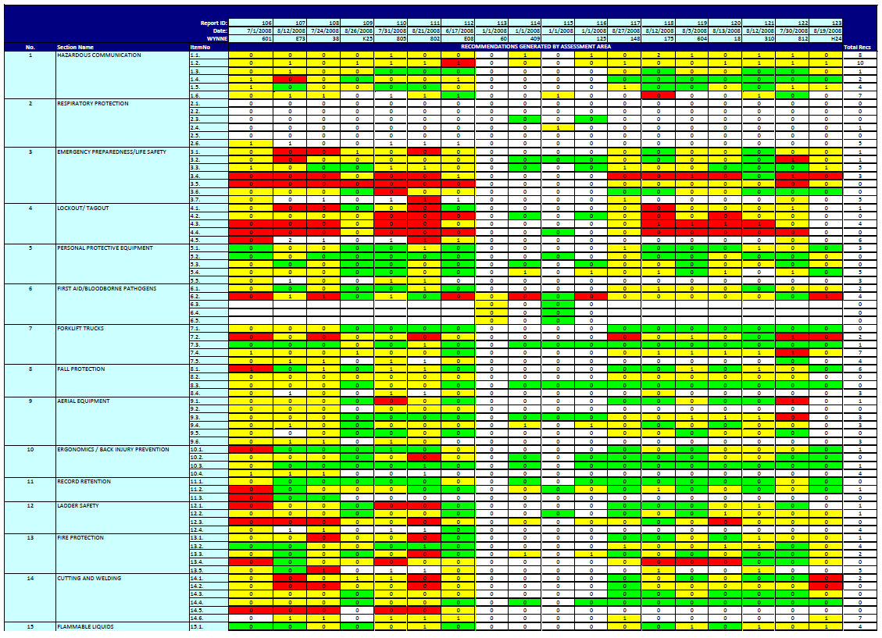
Activity Based Benchmarking Example (Internal)

Slide 5
Risk Management Benchmarking Types
Results Based- Organization benchmarks on results/ outcomes (Trailing Indicators). Can include such items as:
“Open data sources”
Frequency per man hour (OSHA like benchmarking)
Dimensions database/ WCRI
NCCI, etc.
Risk Program
Cost of Risk per unit of exposure (FTE, sales, payroll, units)
Frequency per unit of exposures
Insurance retentions/ deductibles
Premium
Claim Activity - Detail
Surveys
Advantages:
Answers “how am I really doing?”
Gets management attention.
Disadvantages
Maybe difficult to do.
Changes in results are slow to show.
Everyone wants to externally benchmark, but is resistant to sharing their own internal data.

Slide 6
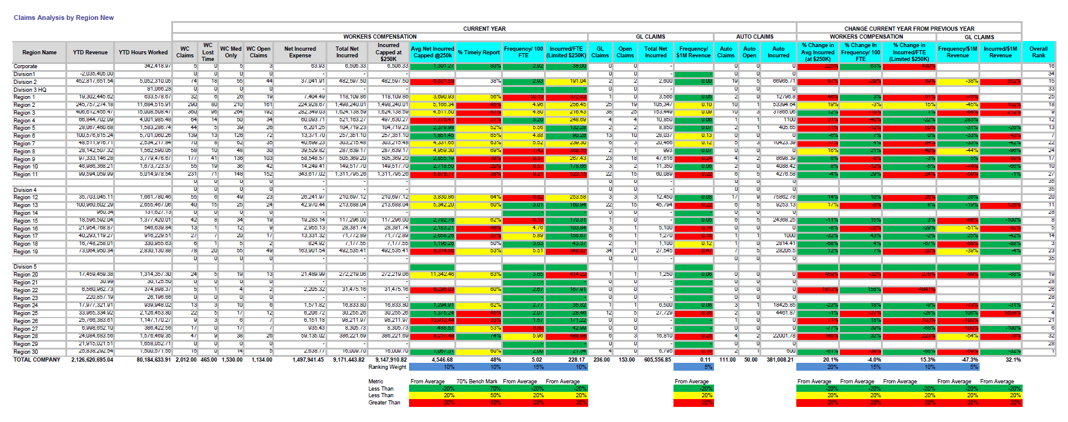
Results Based Benchmarking Example (Internal)

Slide 7
Risk Management Benchmarking Types
Open Data Sources
Examples WCRI, OSHA, NCCI
Advantages:
Usually easier to get
Doesn’t usually requiring providing your data.
Disadvantages
May not be specific enough (may not be by class code, size of organization, etc.)
May not be current
Benchmarks may not be useful.

Slide 8
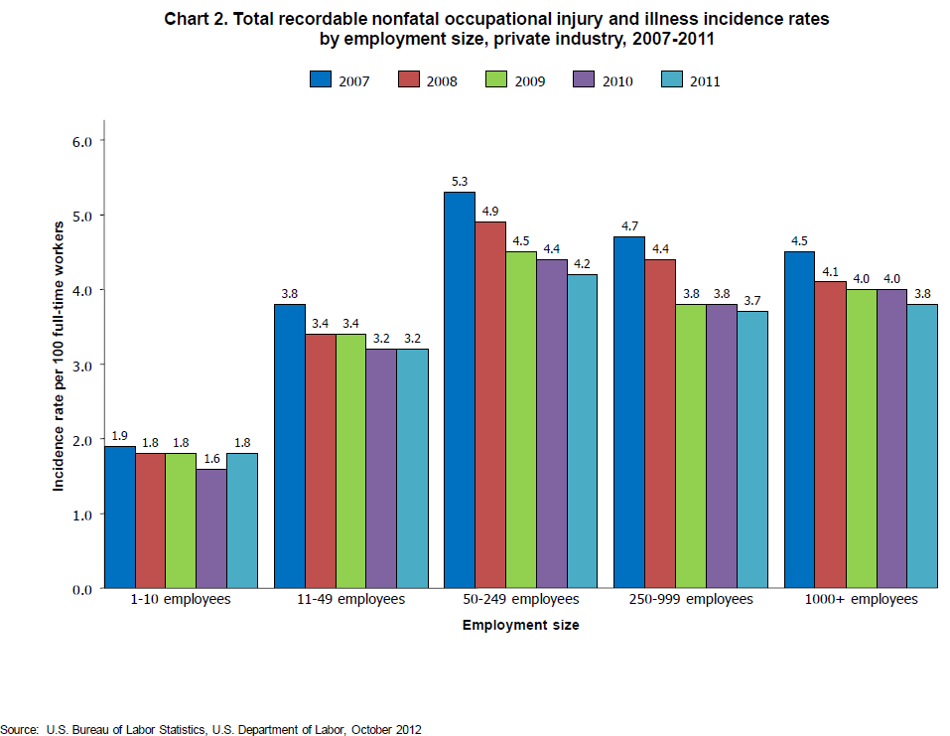
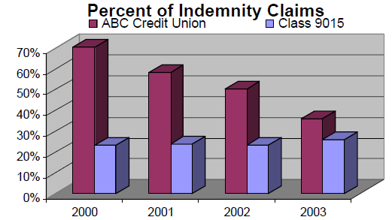
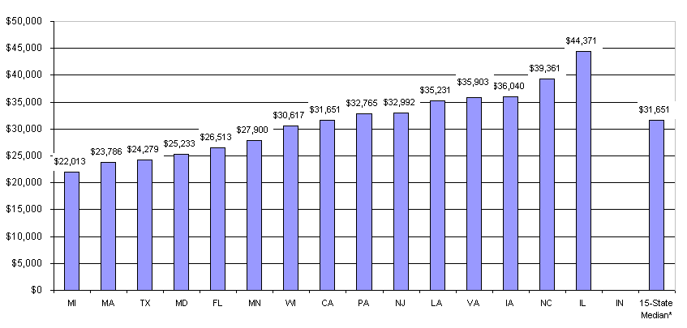
Open Source: Examples
Source: Dimensions database valued 12/31/2003
Average Incurred Benefit per Claim with More Than 7 Days of Lost Time, 2010/2011. Source: WCRI

Slide 9
Risk Management Benchmarking Types
Risk Program
Advantages:
Results based on financial performance
Benchmarks appetite for risk
Compares how well the program runs and what the prices in the marketplace look like.
Might provide leverage for renewal
Disadvantages
Usually very difficult to get
Information is usually proprietary.
Getting a data size that is statistically significant is difficult
Can be driven by market conditions, “long term” deals, financial structure of the organization, etc.

Slide 10
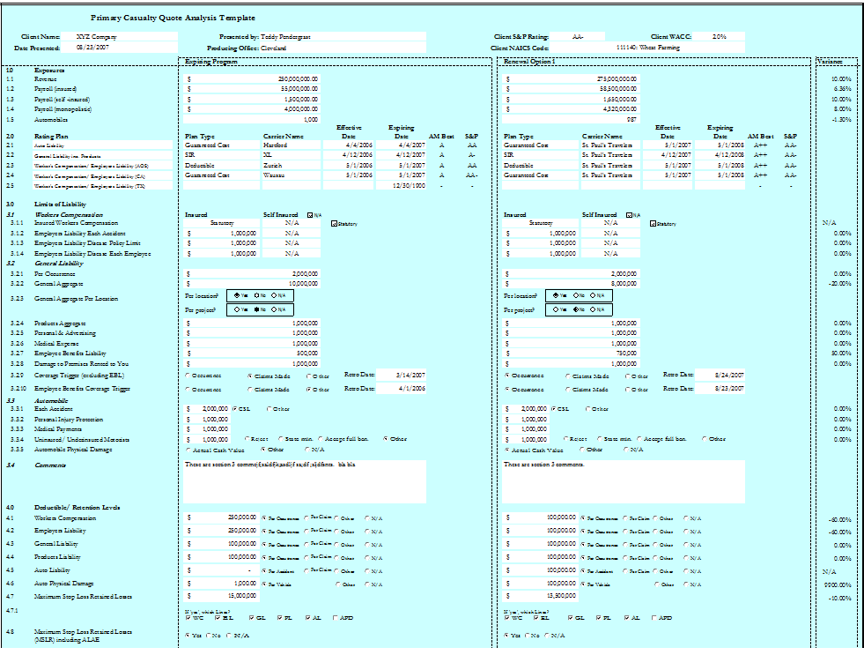
Risk Program: Example

Slide 11
Risk Management Benchmarking Types
Claim Detail
Advantages:
Provides probably the best way to parse data
Can provide benchmarks for claim outcomes, TPA/ Carrier performance
Can provide details for valuable comparison such as
Cost per employee
Losses cost/ type by class code/ occupation
Best for hardcore data analytics and “data mining”.
Disadvantages
Requires exposure basis for best results (payroll, sales, units)
Jurisdictional influence
Getting a data size that is statistically significant is difficult
Requires participants to share a lot of data

Slide 12
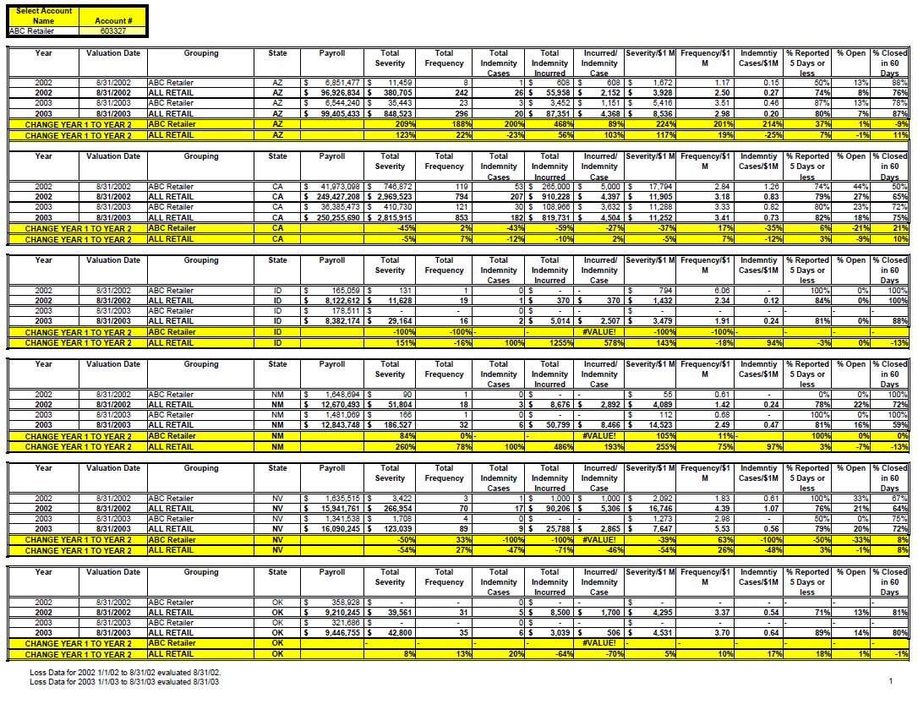
Claim Detail: Example
Claim Detail Sample Benchmark

Slide 13
Risk Management Benchmarking Types
Surveys
Advantages:
Probably the easiest to execute
Can be made so as to not provide very sensitive information
Tailored for specific industries.
Least time consuming for the participants.
Disadvantages
Information may not be detailed enough to address jurisdictional influence.
Benchmarks might be “general” in nature.

Slide 14
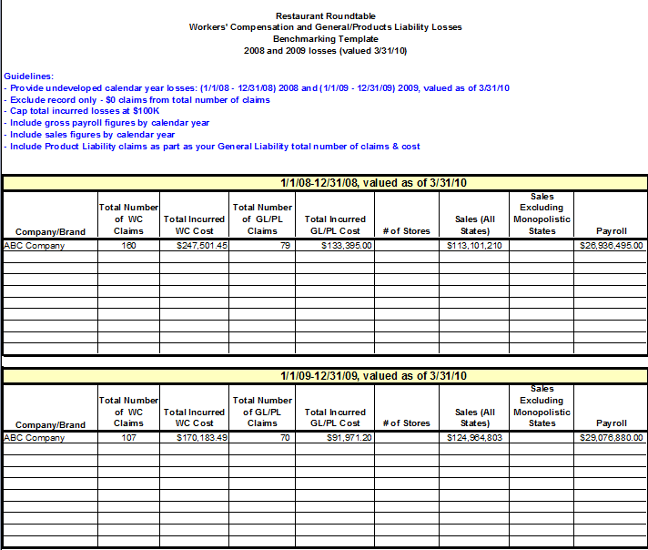
Survey: Restaurant Example

Slide 15
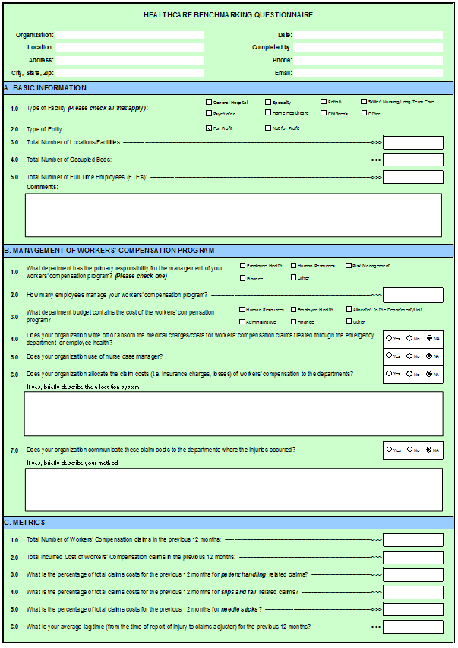
Survey: Healthcare Example

Slide 16
Questions?

